Slide 1
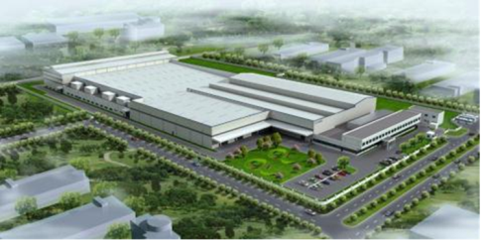
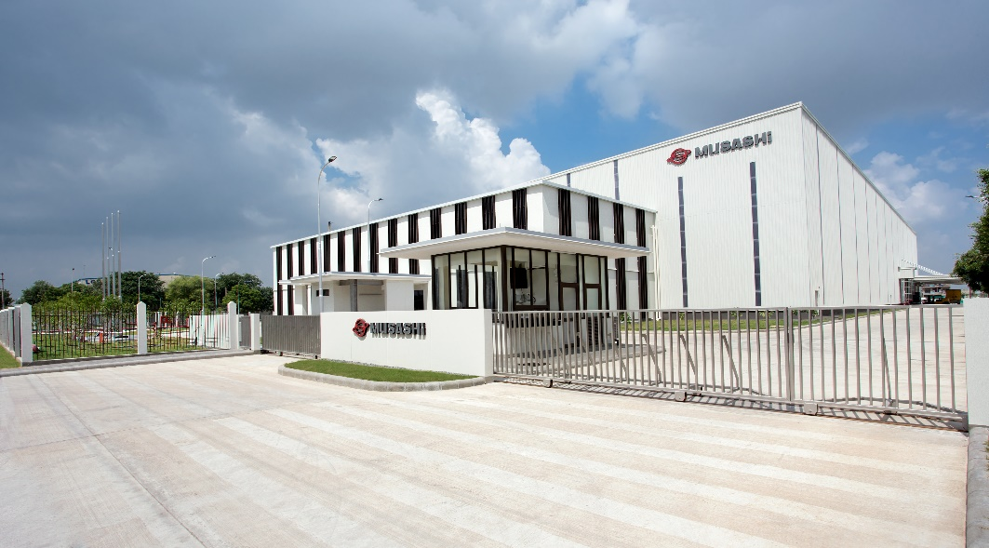
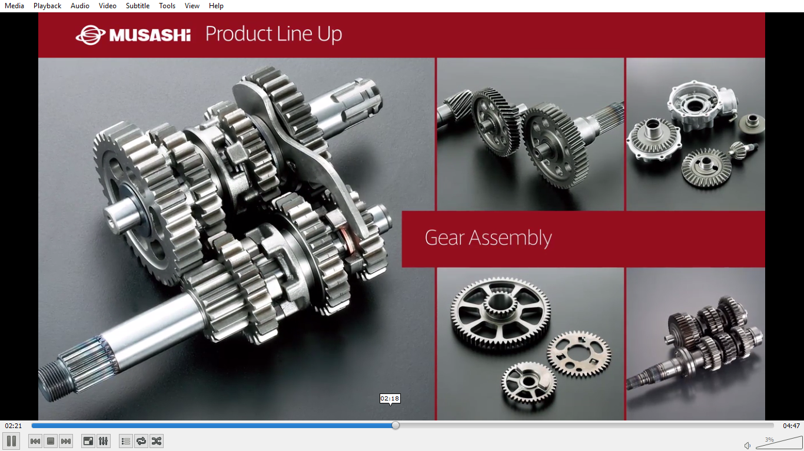
DOJO TRAINING INFORMATION
(a step towards “Zero Defect”)
MAP-ID (BWL-I)
MAP-ID (BWL-II)
DOJO
(MAP-ID)

Slide 2
Contents
S.No. | Contents | Slide No.
1 | Introduction Of DOJO DOJO Background, Purpose | 3 ~ 4
2 | DOJO Journey Activity Schedule DOJO Concept | 5~7
3 | DOJO Process DOJO Layout, Training Schedule b) Evaluation | 8~13

Slide 3
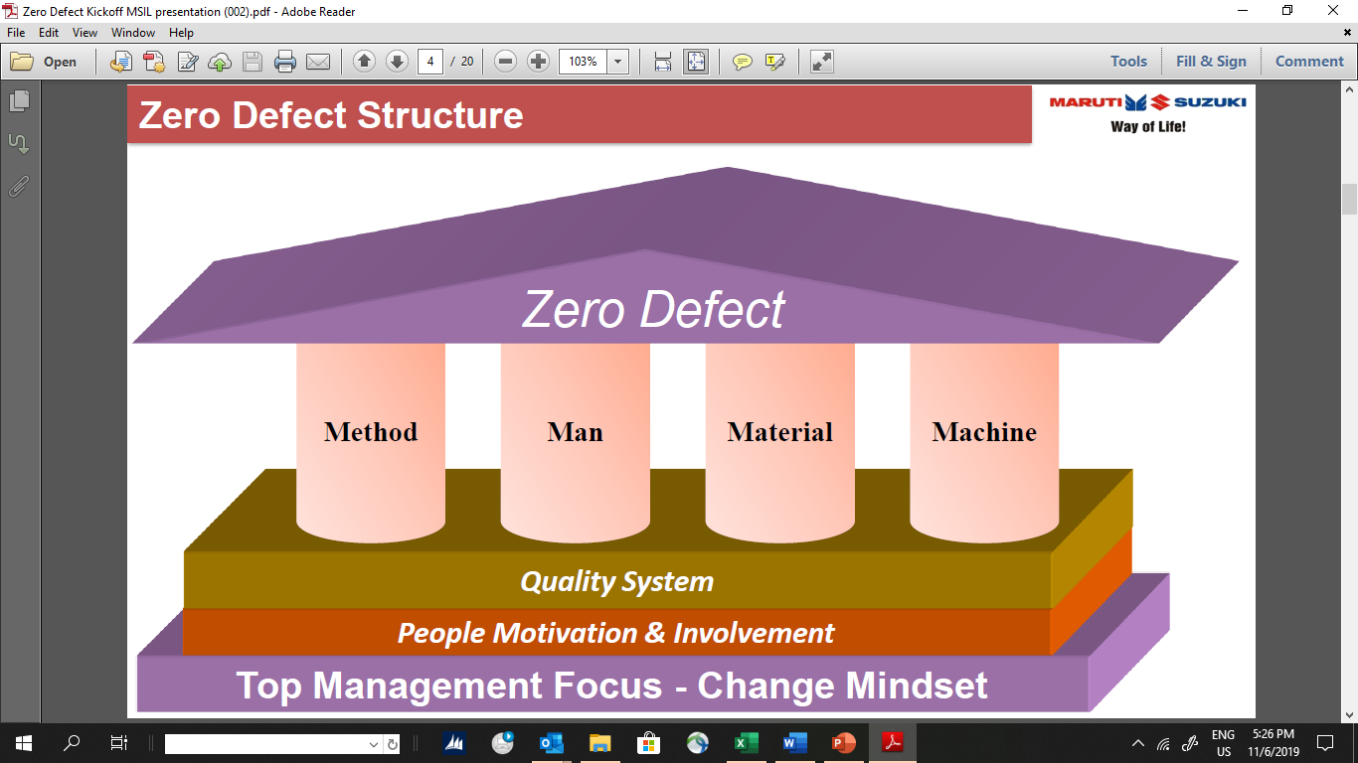
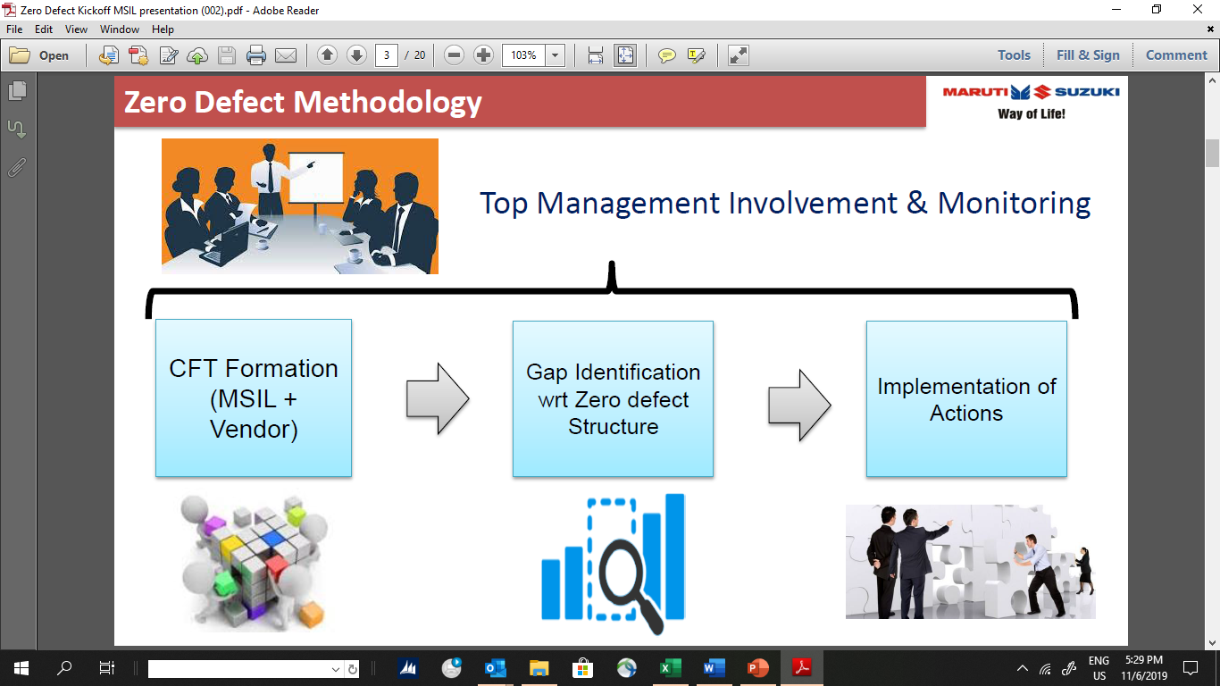
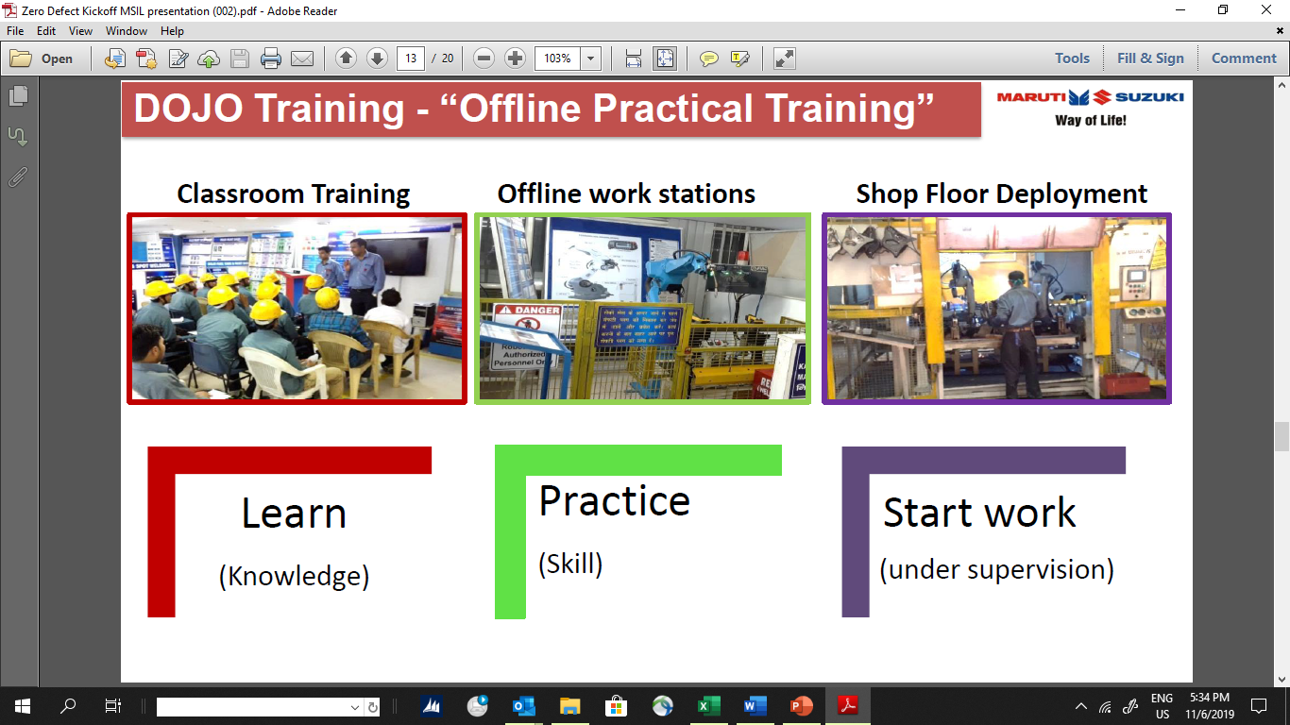

Background
Source : MSIL Standard
Zero Defect Structure
Zero Defect Methodology
DOJO Process Under “Zero Defect Project”
As per MSIL 90% cause of the
defects are “Human Error”

Slide 4


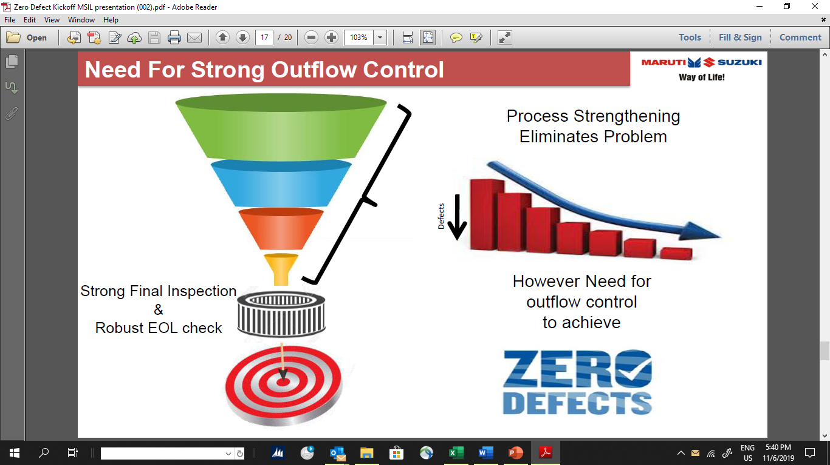

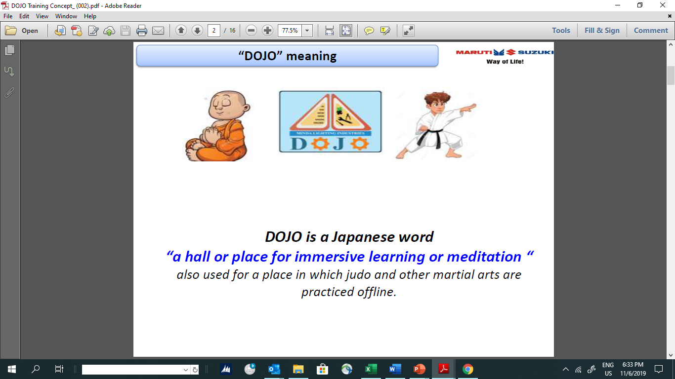
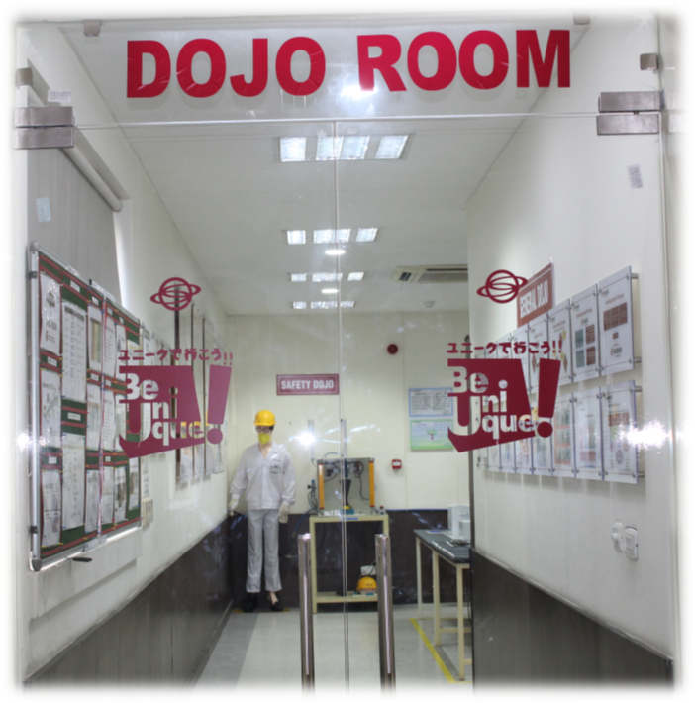
PURPOSE
Strong Outflow Control
Aim
Skill Upgradation
By Implementing Dojo

Slide 5
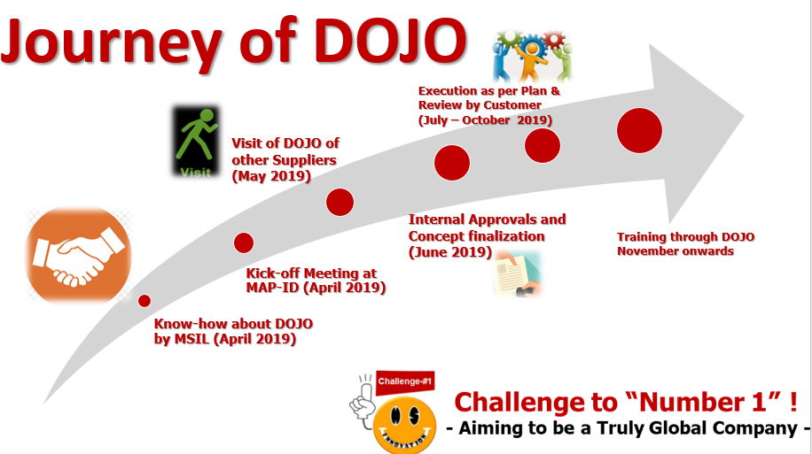
DOJO Journey

Slide 6



DOJO JOURNEY (CONCEPT)
Before Situation
Class Room Training
Deployment
Evaluation
Learn
Start Work
After Situation
Class Room Training
Training on 8 Step of DOJO
Practice
Evaluation
Deployment
Evaluation
At each step
Deployment
Under Supervision
Learn
Knowledge
Practice
Skill

Slide 7
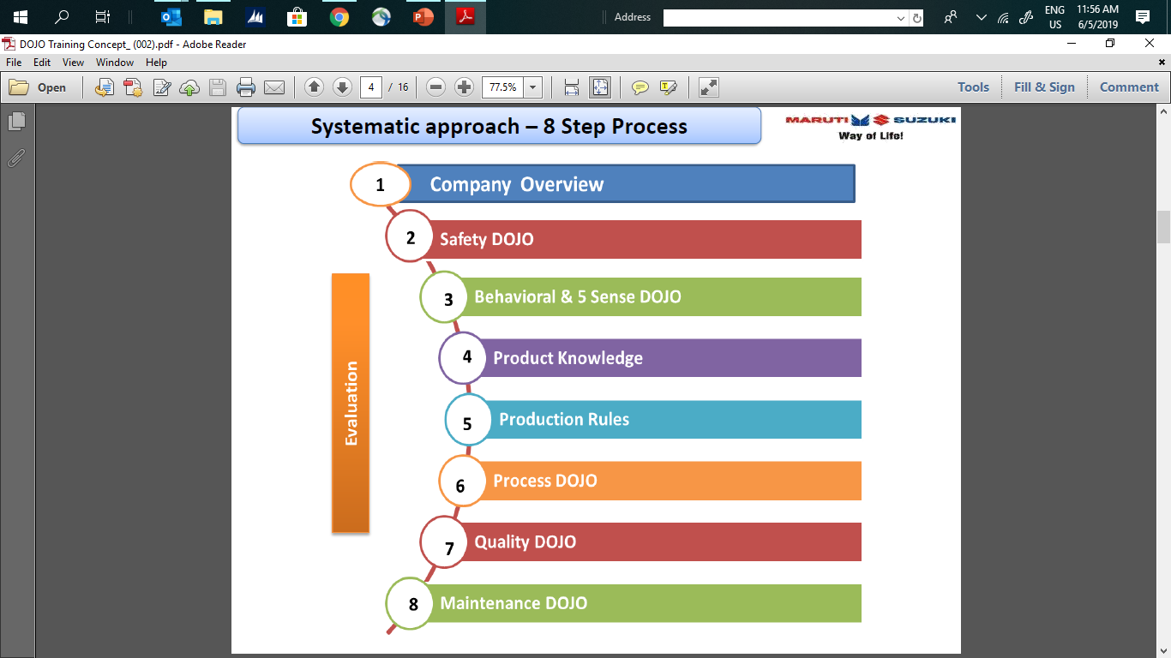
DOJO PROCESS
8 Steps of DOJO
Input from MSIL
DOJO Training
Standard Module
Training on each step
Practical on Process
Evaluation
Feedback after deployment

Slide 8
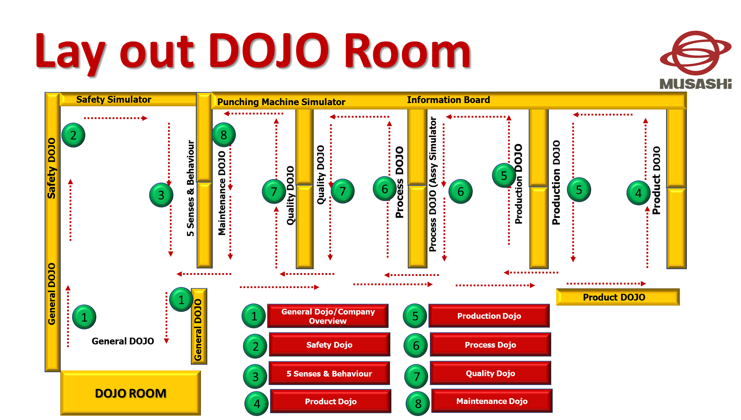
DOJO LAYOUT

Slide 9
DOJO TRAINING SCHEDULE
S.NO. | DOJO STEP | PURPOSE | CONTENT | TRG HOURS | Methodology
1 | GENERAL DOJO/COMPANY OVERVIEW | To give know-how about Musashi Philosophy, Business, Rules and Regulation | Introduction of Musashi Group | 4 Hours | Class Room
 |  |  | Musashi Philosophy |  | (Training Video : Musashi History, Corporate Video)
 |  |  | General rules & Regulations
2 | SAFETY DOJO | To give know-how on imporatnce of Safety | Safety Video & Simulators | 4 Hours | Class Room
 |  |  | Causes of accidents |  | (Training Video : Safety, unsafe Act)
 |  |  | Fire & Its type
 |  |  | Fire Extinguisher & Its Type
 |  |  | Use of PPE
3 | 5 SENSES DOJO | To make use of Five Senses appropriately | 5S Activities | 4 Hours | Practical Trg
 |  |  | Hands & Eyes Coordination |  | 5 Senses/5 S
 |  |  | Practice session
4 | PRODUCT DOJO | To give know -how on Poduct & its application | Major Products that Musashi Manufacture for 2W & 4W | 4 Hours | Information board at DOJO
 |  |  | Application of product
5 | PRODUCTION DOJO | To give education on Production rules and regulations | Details & Practice of Prod.Doc. | 8 Hours | Information board at DOJO, Practice of reading and filling of Production documents
 |  |  | Material Handling
 |  |  | 4M Change Basic Rule
6 | PROCESS DOJO | To give education on Production rules and regulations | Process Know-how | 8 Hours | Information board at DOJO, Assy Process Practice, Video on processes (Forging, LBW,Ball joint,Induction Hardening)
 |  |  | Tooling and Fixtures know-how
 |  |  | Assembly Process practice
7 | QUALITY DOJO | To give education on Quality rules and regulations,Use of Equipments and Guages | Instruments & Gauges | 8 Hours | Information board at DOJO, Practice on use of Equipment, Guages, Identification of Defect parts,etc
 |  |  | Defects
 |  |  | Practice on Defects Identification, Measurement practice
8 | MAINTENANCE DOJO | To educate on Maintenance rules and dicuments | Tools Used In Maintenance | 4 Hours | Information board at DOJO
 |  |  | Practice With Tools
 |  |  | Maintenance & Its Type
 |  |  | Maintenance Documents

Slide 10
Evaluation Methodology
Dojo Step | Written Test | Passing Criteria
General Dojo | 100% | 70%
Safety Dojo | 100% | 70%
5 Senses & Behavioral | 100% | 70%
Product Dojo | 100% | 70%
Production Dojo | 100% | 70%
Process Dojo | 100% | 70%
Quality Dojo | 100% | 70%
Maintenance Dojo | 100% | 70%

Slide 11

Thank you very much

